Slide 1

BIKE SALE ANALYSIS
PERFORMANCE INSIGHTS & STRATEGIC TRENDS
BIKE SALE DASHBOARD REPORT

Slide 2


EXECUTIVE OVERVIEW
Strong Market Balance: Near-even split between male and female purchasers.
Peak Demographics: Maximum engagement observed in the 40-year-old age bin.
Commute Sensitivity: High purchase rates for short commutes (0-1 miles).
Income Correlation: Higher average income correlates with a "Yes" for bike purchase across all genders.

Slide 3
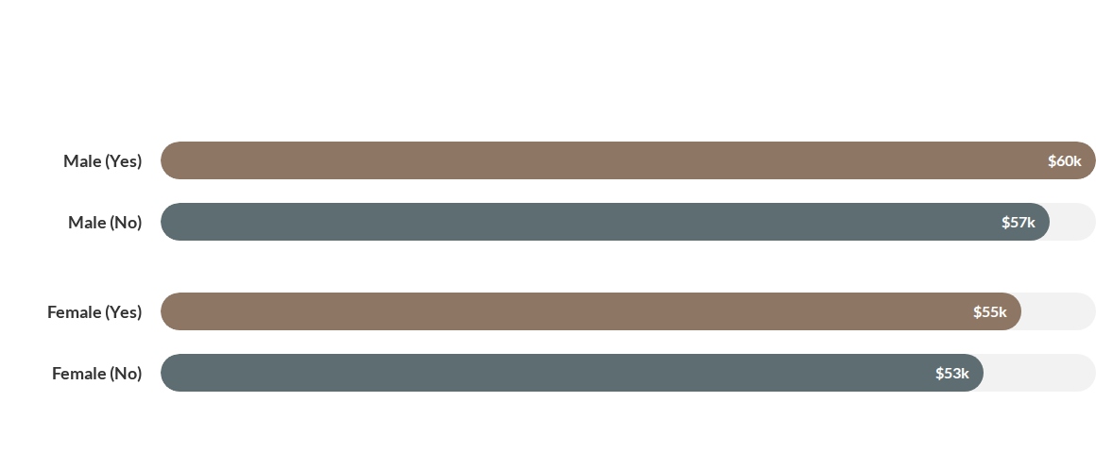
INCOME PER PURCHASE GROUP
Data reveals that customers who purchased a bike have a higher average income compared to those who did not.

Slide 4


COMMUTE PROXIMITY
0-1 Mile commutes represent the "sweet spot" for bike sales, with 171 successful purchases recorded.
Conversely, customers with 10+ miles commutes are least likely to purchase, showing a steep decline in interest as distance increases.
Insights suggest that bikes are primarily viewed as a solution for short-range micro-mobility.

Slide 5


AGE DEMOGRAPHIC PEAK
Targeting customers in their peak earning and activity years yields the highest conversion rates.
40
185
20.3M
PRIMARY AGE BIN
SALES AT PEAK (AGE 40)
TOTAL REVENUE GROUP

Slide 6


MARKET SHARE BY GENDER
Male: 525 Purchasers (51%)
Female: 501 Purchasers (49%)
1,026
The customer base is exceptionally balanced, suggesting that gender-neutral marketing strategies are highly effective.
Total Purchasers

Slide 7






ACTIONABLE STRATEGIES
Targeted Ads
Short-Range Focus
Premium Tiers
Focus high-budget digital campaigns on the 35-45 age bracket, as they represent the highest conversion potential.
Market bikes as the ultimate "First/Last Mile" solution for commuters living within 2 miles of their workplace.
Develop premium bike models for the Male segment ($60k avg income) and tailored accessories for the Female segment.

Slide 8



Questions?
Thank you for your attention to the Bike Sales Dashboard Analysis.

